Slide 1
Introduction
Group: AI-vision
Leader : Nguyễn Thị Hường
Member : Vũ Phương Thùy, Phạm Tiến Thành Công
Teacher : Lê Minh Huy

Slide 2
GANs
Generative adversarial networks(GAN) ?

Slide 3
GANs
Generative adversarial networks(GAN)
What are GANs ?
Applications of GANs ?

Slide 4
What are GANs ?
What are GANs ???

Slide 5
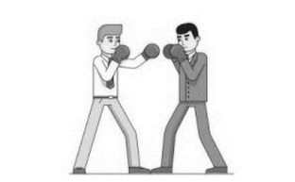
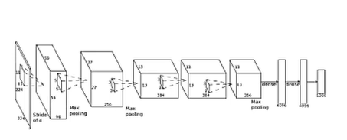
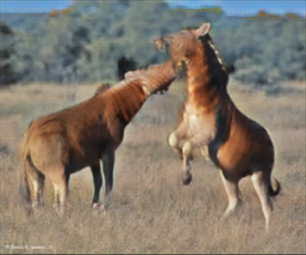
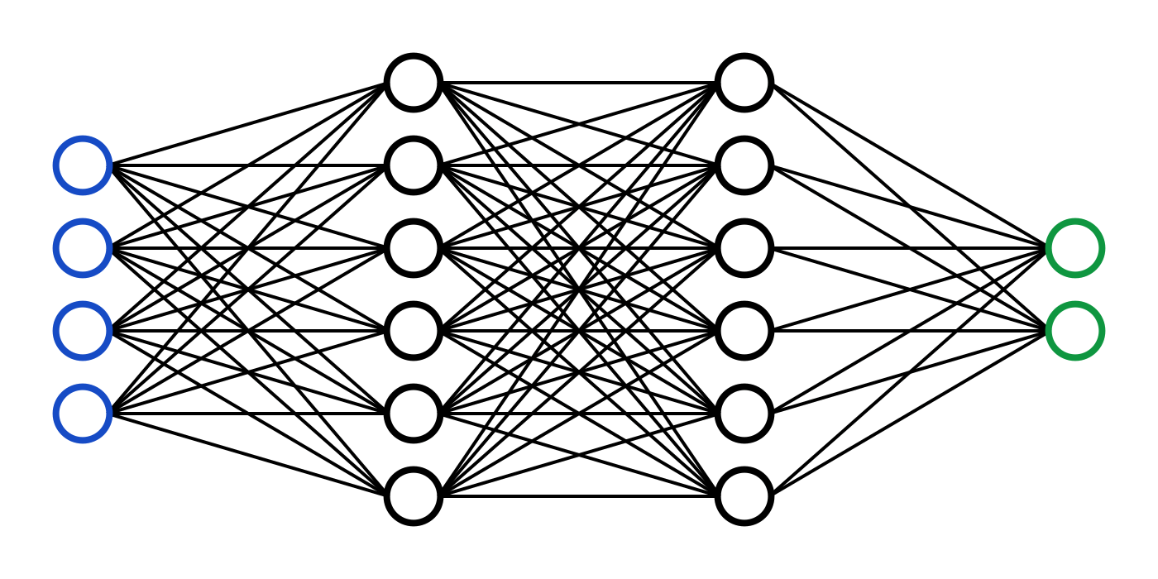
What are GANs ?
GANs is an unsupervised learning algorithm developed by Ian J. Goodfellow in 2014
Genrative
Genrative data
(Creates fake data)
Adversarial
Generator and discriminator, each competing to win
Generator trying to fake and Discriminator, trying not to be fooled
Networks

Slide 6
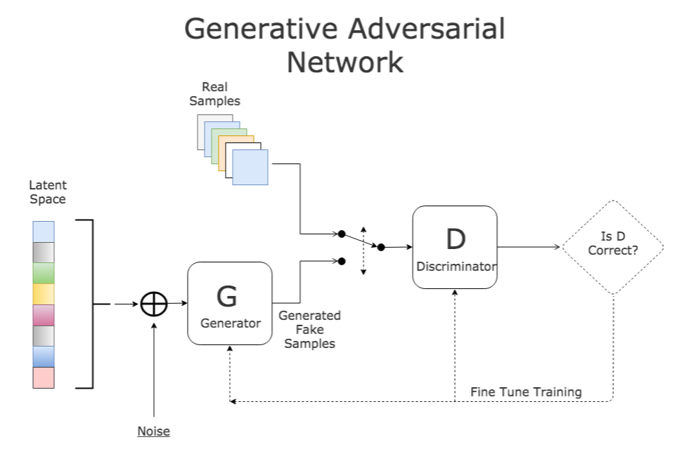
What are GANs ?
How it works:

Slide 7
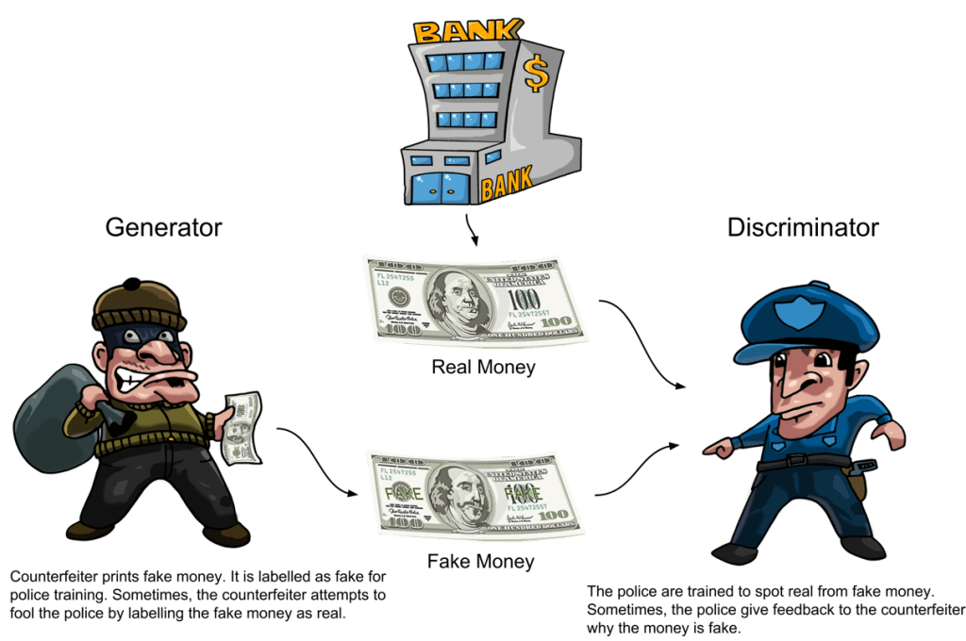
What are GANs ?
- example of GAN:
source: https://dzone.com/articles/working-principles-of-generative-adversarial-netwo

Slide 8
Applications of GANs ?
Applications of GANs ?

Slide 9
Applications of GANs ?
Image to image translation
Generate face (StyleGAN)
Text to image translation
Super resolution

Slide 10
Applications of GANs ?
Image to image translation

Slide 11
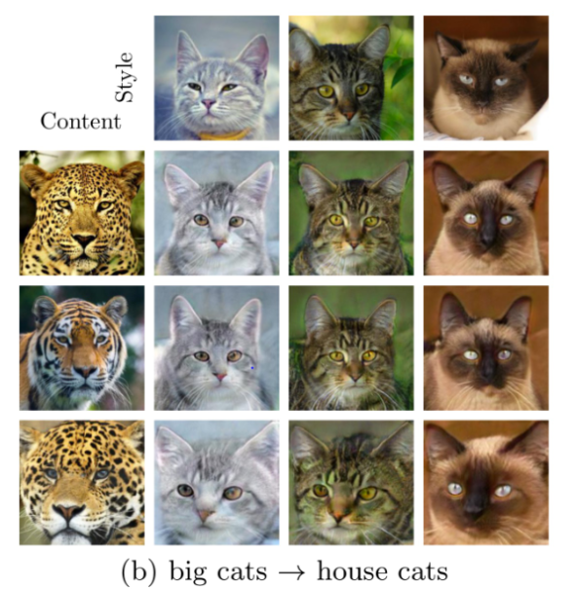
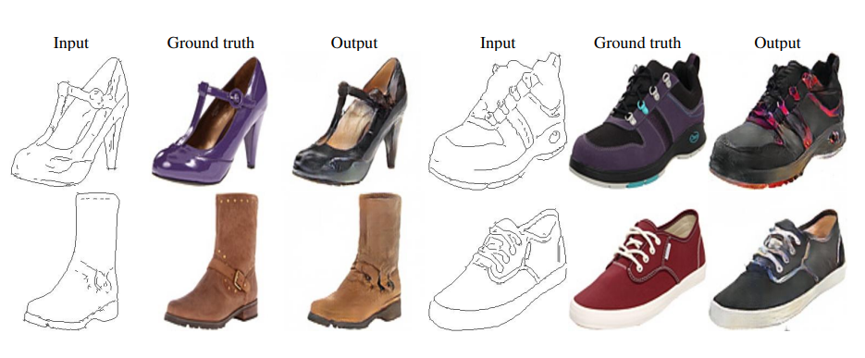
Applications of GANs ?
1. Image to image translation
Uses: change the properties in the image(colorless to colored, change style, increase resolution,…)

Slide 12
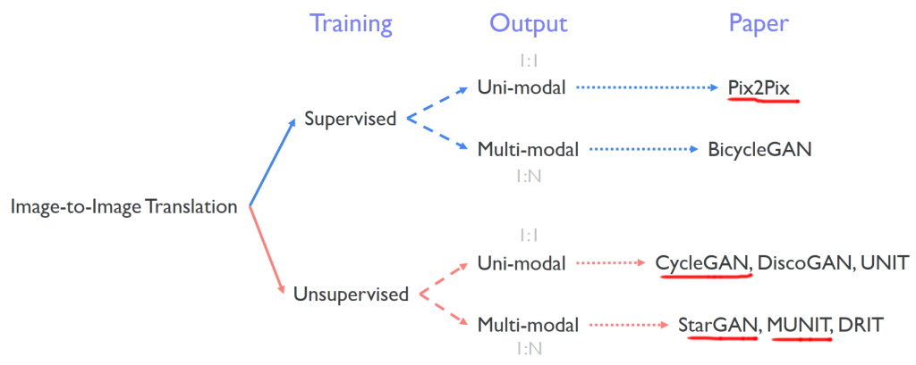
Applications of GANs ?
1. Image to image translation
- Types of Image to image translation

Slide 13
Applications of GANs ?
1. Image to image translation
CycleGAN

Slide 14
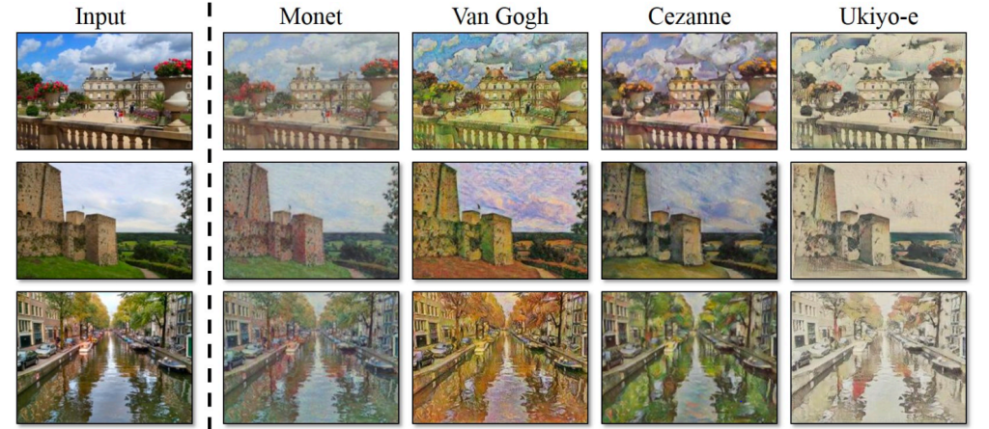
Applications of GANs ?
1. Image to image translation - CycleGANs
Concept: CycleGAN is a GAN architecture used to convert different styles between images

Slide 15
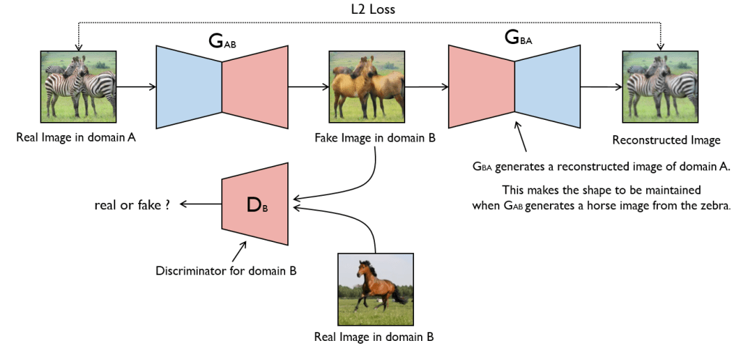
Applications of GANs ?
1. Image to image translation - CycleGANs
- CycleGAN consists of 2 Generator and 2 Discriminator.
- Works: Convert 1 image from domain A to domain B then back to domain A, so that it matches the origin

Slide 16
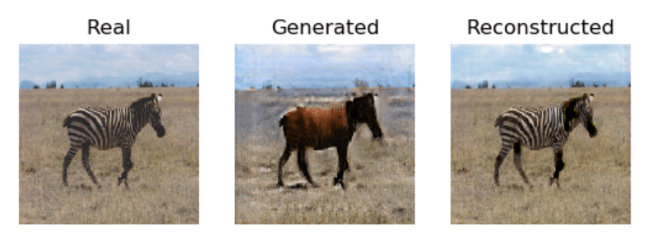
Applications of GANs ?
1. Image to image translation - CycleGANs
CycleGANs Works

Slide 17
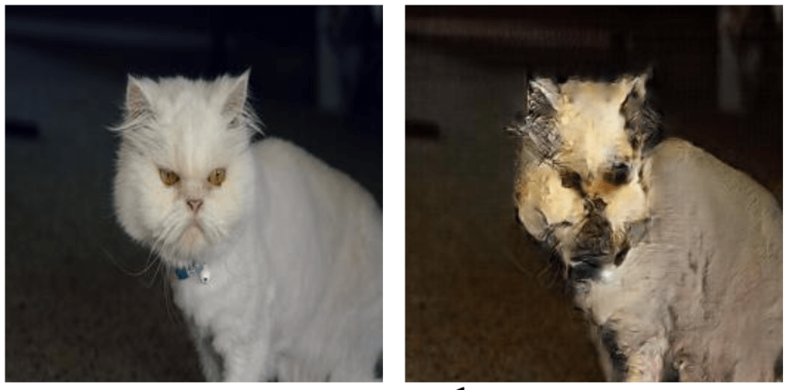
Applications of GANs ?
1. Image to image translation - CycleGANs
CycleGan is usually only good for tasks that involve changing colors (styles) like day to night, but for tasks that have large changes in the shape of the input and output, the results are not good.

Slide 18
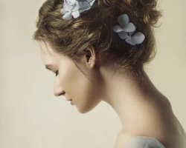
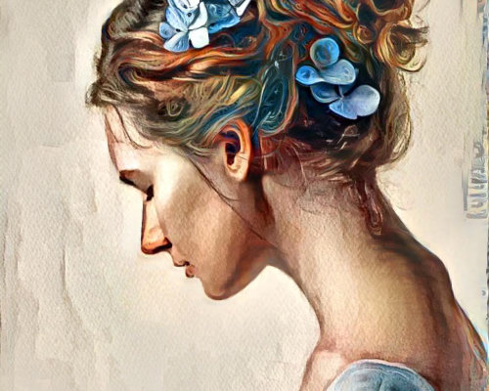
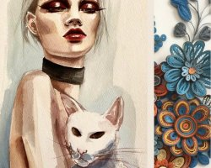
Applications of GANs ?
1. Image to image translation - CycleGANs
Paper: https://arxiv.org/abs/1703.10593v7
CycleGAN emulator site: https://deepdreamgenerator.com/

Slide 19
Applications of GANs ?
1. Image to image translation
pix2pix

Slide 20
Applications of GANs ?
1. Image to image translation – Pix2pix
-Pix2pix is a supervised learning uni-model image to image translation algorithm.
-With input is a drawing without color, the output is a colored image

Slide 21
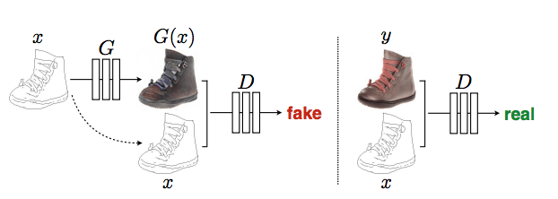
Applications of GANs ?
1. Image to image translation – Pix2pix
Pix2pix is a GAN network, so it also has Generator (G) to generate fake images and Discriminator (D) to distinguish real and fake images.
Discriminator learns by distinguishing that x and G(x) are fake images, x and y are real images. Otherwise, the generator will learn by letting x and G(x) be real images.

Slide 22
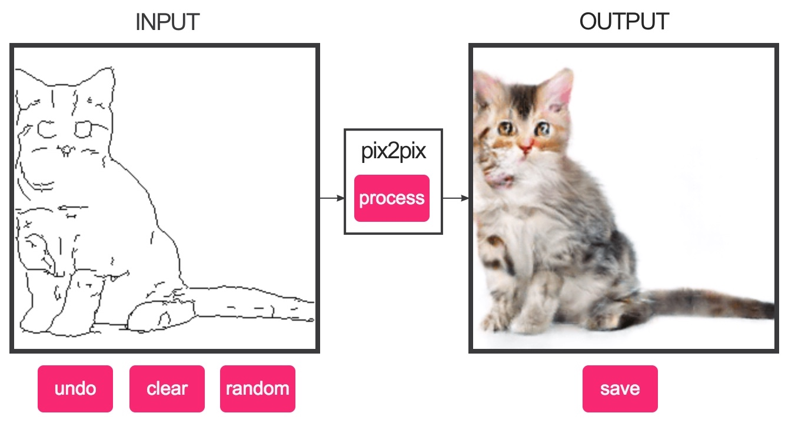
Applications of GANs ?
1. Image to image translation – Pix2pix
Paper: https://arxiv.org/pdf/1611.07004.pdf
Pix2pix emulator site: https://affinelayer.com/pixsrv/

Slide 23
Applications of GANs ?
2. Generate face (StyleGAN)

Slide 24
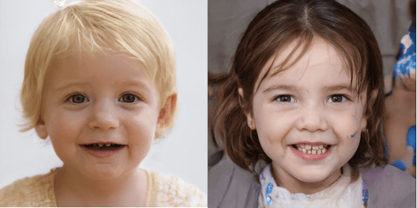
Applications of GANs ?
2. Generate face (StyleGAN)
StyleGAN model was introduced by NVIDIA in 2018.
StyleGAN introduces a new generator architecture that allows us to control the level of detail of an image from coarse details (head shape, hairstyle...) to finer details (eye color, earrings, etc.). .).
StyleGAN is capable of producing very high resolution images.
Fake images
https://thispersondoesnotexist.com/

Slide 25
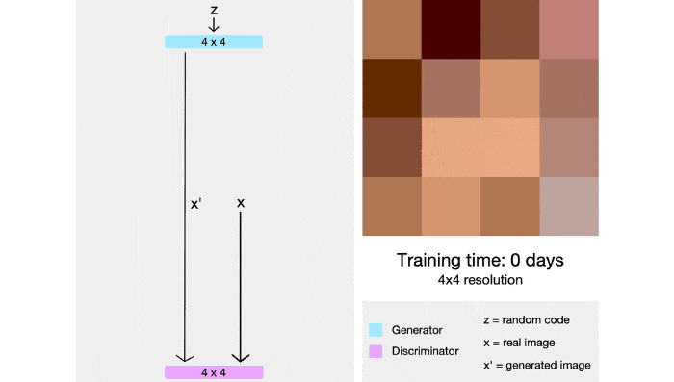
Applications of GANs ?
2. Generate face (StyleGAN)
Have 2 generator and discrminator networks will initially be trained on 4x4 images, after which more layers will be gradually added and the image size will also gradually increase.
With this technique, the training time is greatly shortened and the training process is also more stable
Example

Slide 26
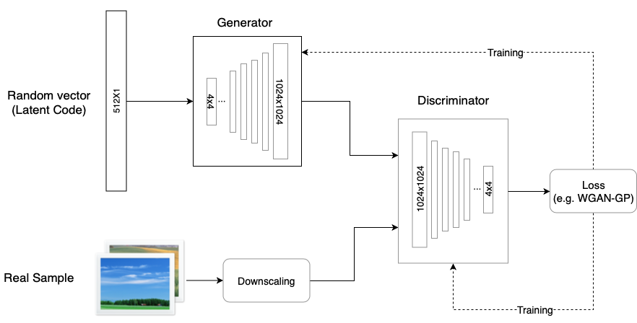
Applications of GANs ?
2. Generate face (StyleGAN)
Diagram of StyleGAN

Slide 27
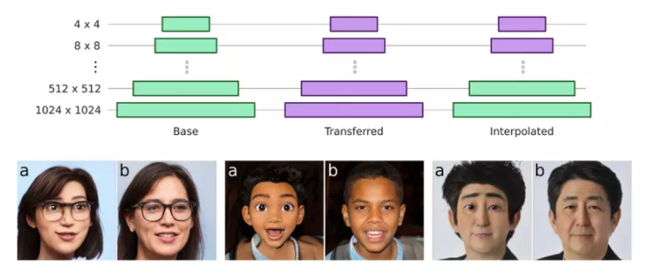
Applications of GANs ?
2. Generate face (StyleGAN)
We can select and blend features generated by different generator networks.
For example, a photo of a real person's face but with the texture of a cartoon character

Slide 28
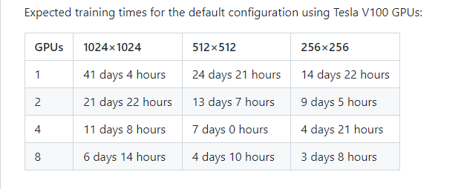
Applications of GANs ?
2. Generate face (StyleGAN)
StyleGAN:

Slide 29
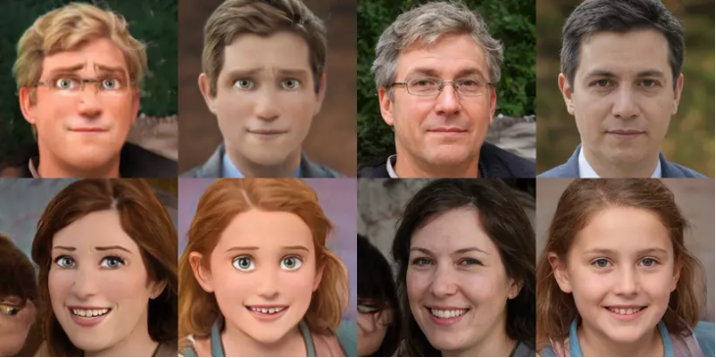
Applications of GANs ?
2. Generate face (StyleGAN)
Example cartoon character:

Slide 30
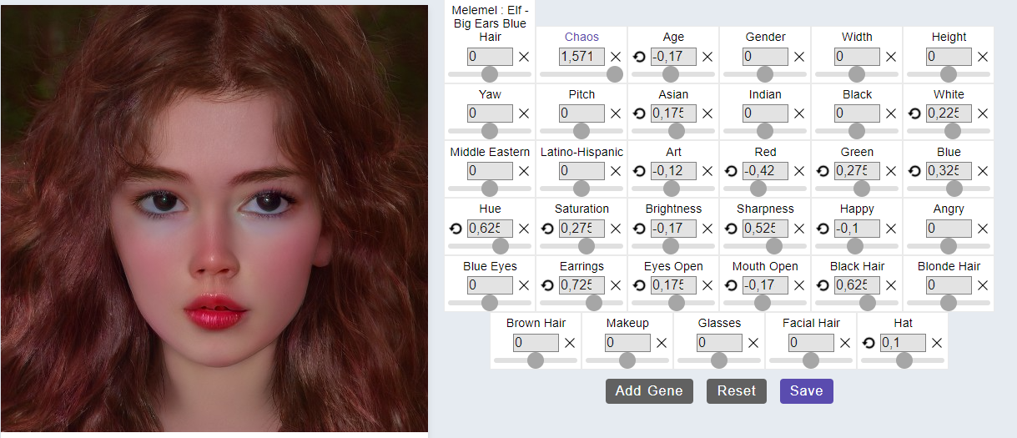
Applications of GANs ?
2. Generate face (StyleGAN)
Paper: https://arxiv.org/pdf/2010.05334.pdf
Website Generate random face images using CycleGAN: https://thispersondoesnotexist.com/
The site creates the image I want: https://www.artbreeder.com/

Slide 31
Applications of GANs ?
3. Text to image translation

Slide 32
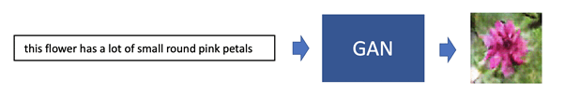
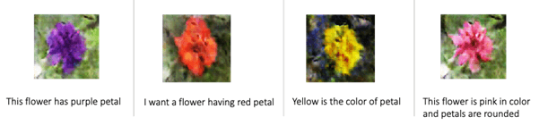
Applications of GANs ?
3. Text to image translation
Text to image has the role of creating an image based on our expectations.
For instance, if you type in "this flower has a lot of small round pink petals," you'll get an image of a flower with round pink petals.

Slide 33
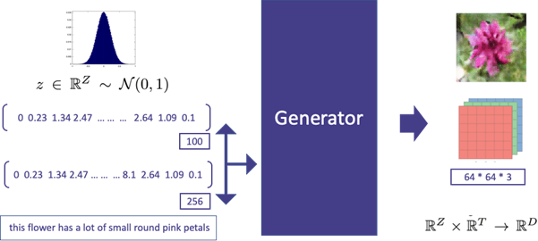
Applications of GANs ?
3. Text to image translation
- Generator: Instead of merely supplying the input noise vector to the Generator then The description text line will be converted to text embedding. It is then connected to the noise vector and fed into the Generator

Slide 34
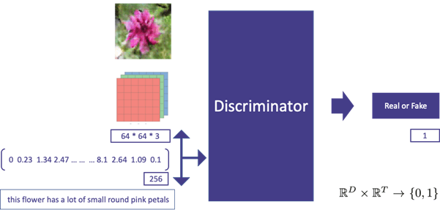
Applications of GANs ?
3. Text to image translation
- Discriminator: Instead of only determining whether an image is real or false, it can also predict whether the image and text match.

Slide 35
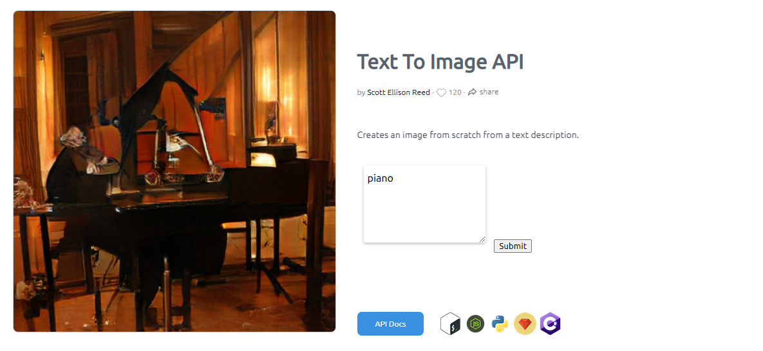
Applications of GANs ?
3. Text to image translation
Paper: https://arxiv.org/pdf/1605.05396.pdf
Text to image translation emulator site: https://deepai.org/machine-learning-model/text2img

Slide 36
Applications of GANs ?
4. Super-resolution

Slide 37
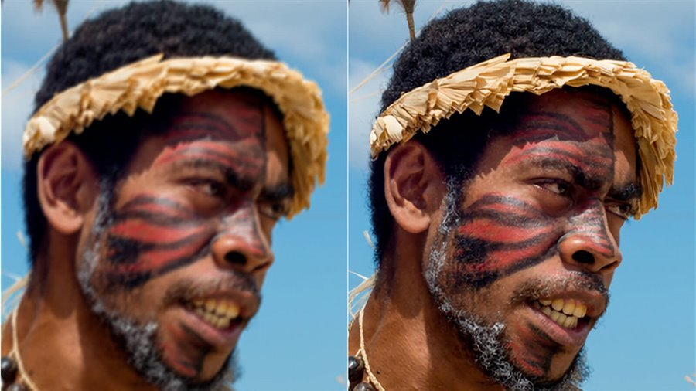
Applications of GANs ?
4. Super-resolution
- Example:

Slide 38
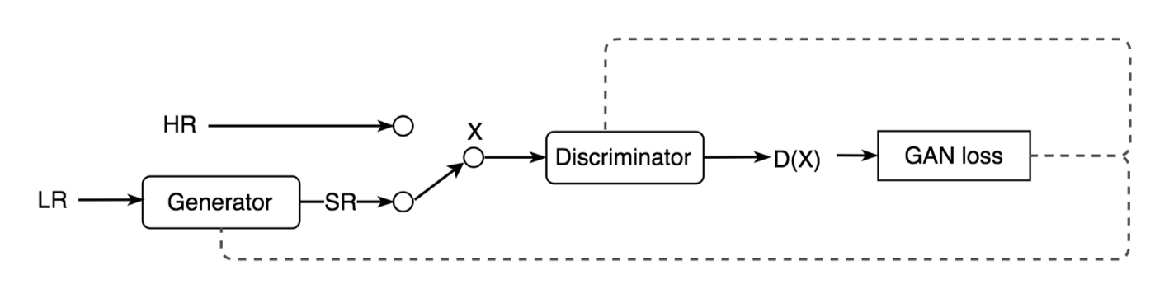
Applications of GANs ?
4. Super-resolution
- Application: Convert low-quality photographs to high-quality images using SRGAN technology.
- Super Resolution, like GAN, has two parts: Generator and Discriminator, with Generator seeking to optimize the generated data so that it can deceive the discriminator

Slide 39
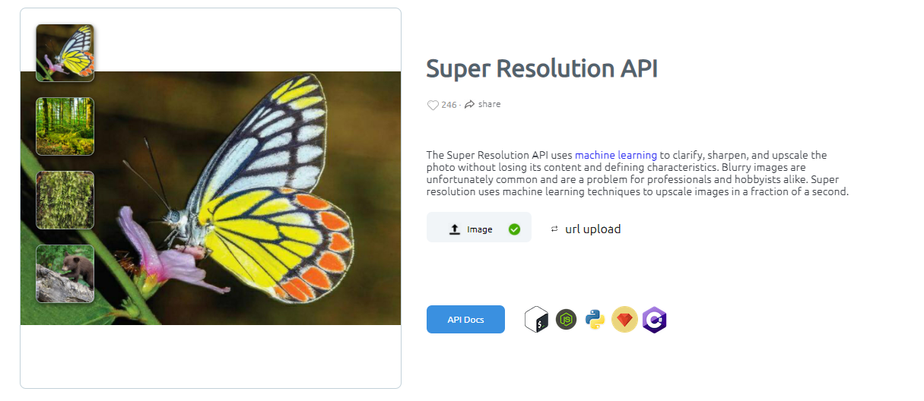
Applications of GANs ?
4. Super-resolution
Paper: https://arxiv.org/pdf/1609.04802.pdf
Super-resolution emulator site: https://deepai.org/machine-learning-model/torch-srgan

Slide 40
Applications of GANs ?
5. Gan in Deep Fakes

Slide 41

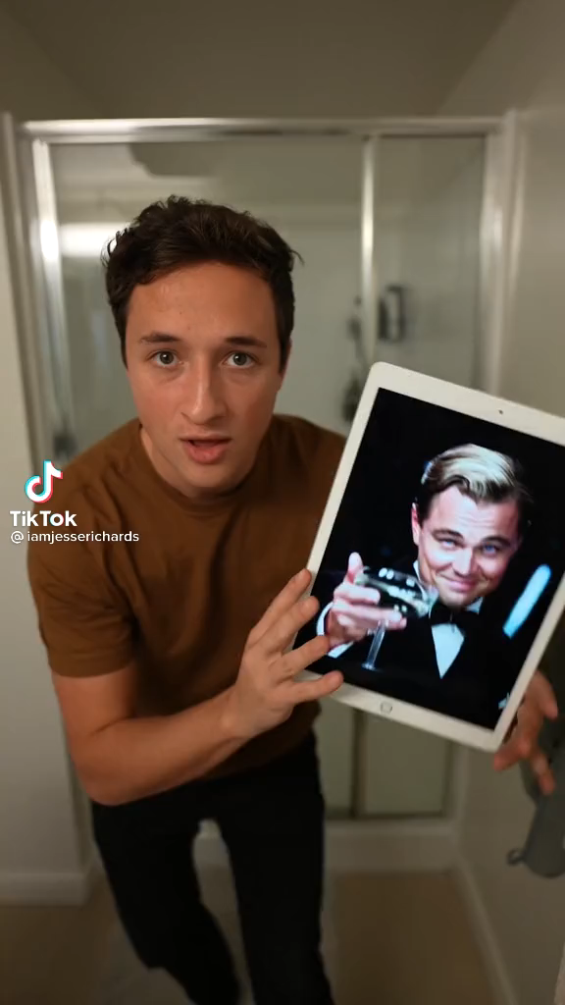
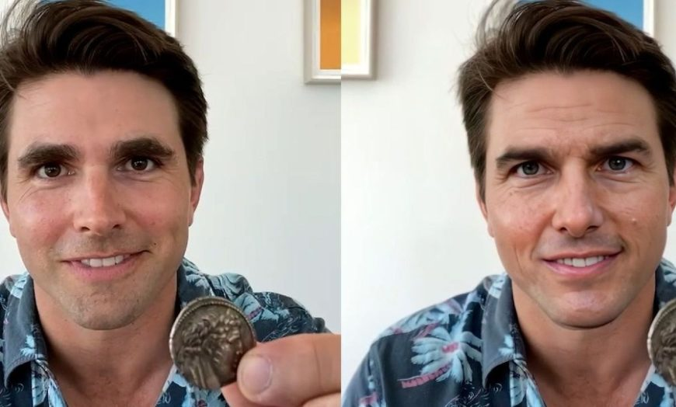

Applications of GANs ?
5. Gan in Deep Fakes
-Example:

Slide 42
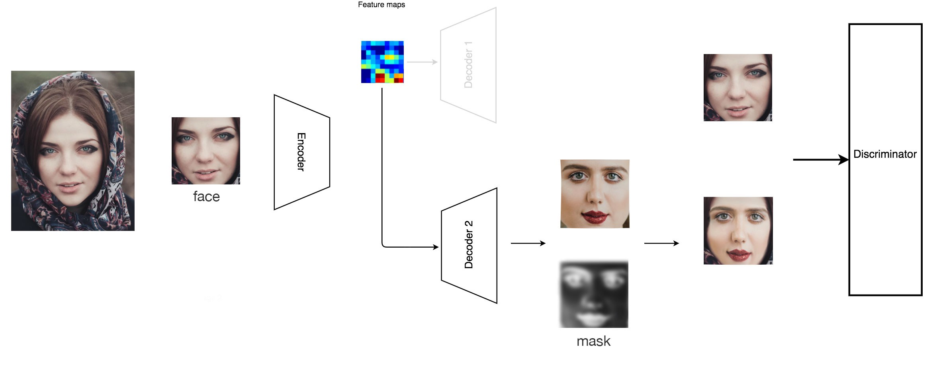
Applications of GANs ?
5. Gan in Deep Fakes
It uses discriminator to distinguish between real images and images created during training
It will employ an autoencoder to create the most realistic visuals possible. the autoencoder functions similarly to a network generator.

Slide 43
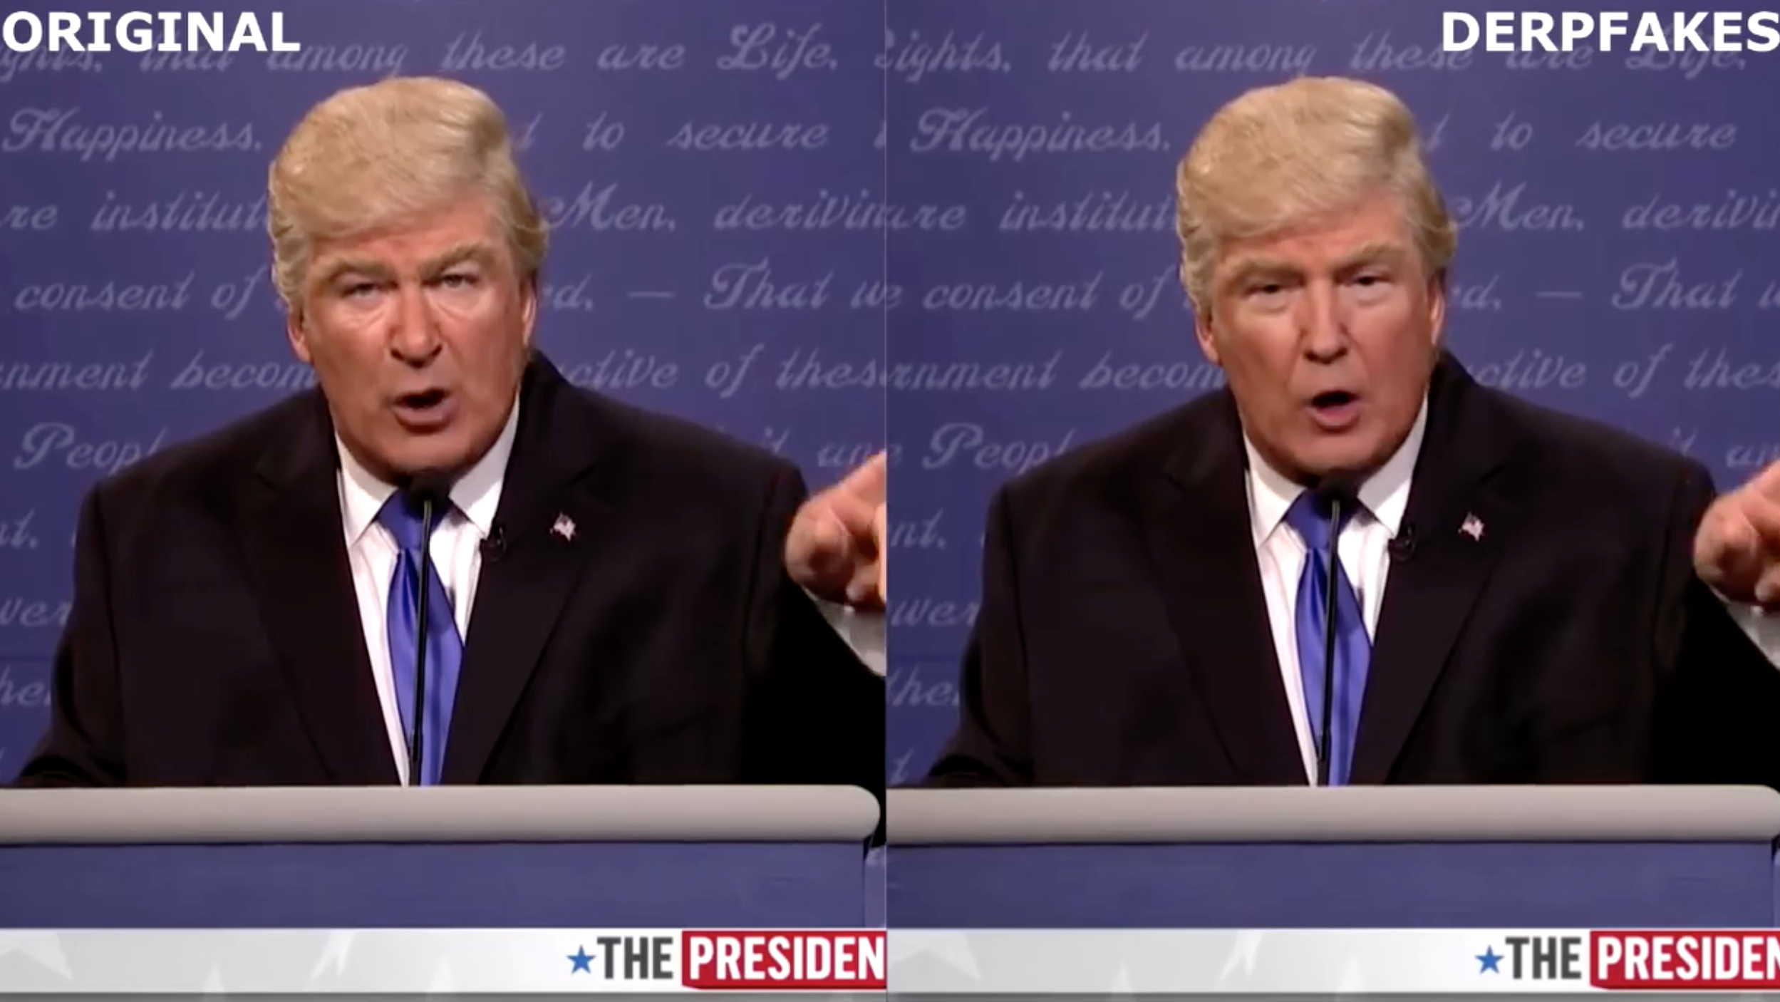
Applications of GANs ?
5. Gan in Deep Fakes
Deep fakes are a novel and potentially harmful technology if not utilized properly. Ethical issues must be at the forefront of this technology and they should only be used for study and development with good intentions.

Slide 44
GAN
Thank You!

